Slide 1

18CSE392T – Machine Learning I
Department of Data Science and Business Systems

Slide 2
Linear algebra

Slide 3
1. Notation
Knowing the notation will help you to read the algorithm descriptions in books, websites and papers to get an knowledge of the happenings.
2. Operations
The working in vectors and matrices can make things still clearer. This can be applied to descriptions and to code. We can apply simple operations like adding, multiplying, inverting, transposing, etc. on the matrices and vectors.

Slide 4
3. Matrix Factorization
Matrix factorization algorithm works by decomposing the matrix into the product of two lower dimensionality rectangular matrices. The idea behind the matrix factorization is to represent users and items in lower dimensional latent space.

Slide 5
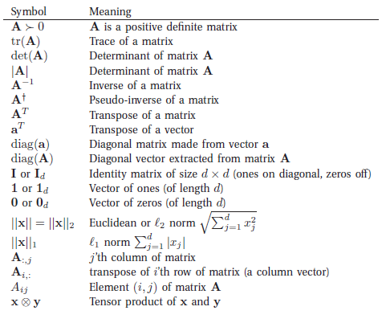
Notations

Slide 6
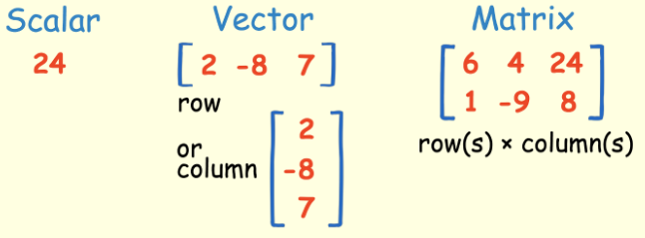
Representation of Data
In Linear Algebra, the data is represented by linear equations, which are presented in the form of matrices and vectors.

Slide 7
Scalar and Vector
A scalar is simply a number.
For example 45.
A Vector is an ordered array of numbers.
A vector can be in a row or a column.
A Vector has a single index, which can point to specific value within the Vector.

Slide 8
Matrix
A Matrix is an ordered 2 dimensional array of numbers and it has two indices.
The first one points to the row and the second one points to the column.
Example: M21 refers to value in second row and first column.
A matrix have multiple number of rows and columns.
Vector is a matrix with one row or one column.

Slide 9
Tensor
Tensor is an array of numbers arranged on a regular grid with a variable number of axes.
A Tensor has three indices, the first one points to the row, the second to the column and the third to the axis.
Example: T232 points to the second row, the third column, and the second axis.

Slide 10
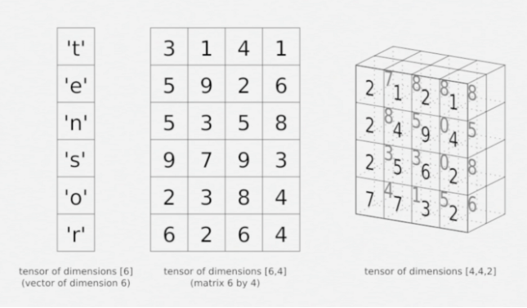
Tensor

Slide 11
Tensor
Tensor is a multidimensional array.
It can be a Vector and a Matrix, depending on the number of indices.
A first-order Tensor would be a Vector (1 index).
A second-order Tensor is a Matrix (2 indices).
A Third-order Tensors (3 indices) and higher are called Higher-Order Tensors.

Slide 12
Operations
Matrix-Scalar Operations
Matrix-Vector Multiplication
Matrix-Matrix Addition and Subtraction
Matrix-Matrix Multiplication

Slide 13


